Slide 1

ROCY RObot Carer for the elderlY
Miguel P. Xochicale
Doctoral Researcher in Human-Robot Interaction
University of Birmingham, UK
@_mxochicale

Slide 2
The world's population over 60 years
The proportion of the world's population over 60 years will nearly double from 12% to 22% between 2015 and 2050. [The World Health Organisation]
2015 >>> 2050
12% >>> 22 %

Slide 3
Challenges for a Healthy Ageing
The World Health Organisation pointed out that some challenges in the Healthy ageing arena are mainly focused on the improvement of methodologies for
Measurement
Monitoring, and
Understanding the physical activity of the elderly.

Slide 4
Caring the Elderly using Humanoid Robots
RIKEN
RIBA-II
ROBOCOACH
PALRO
NAO

Slide 5
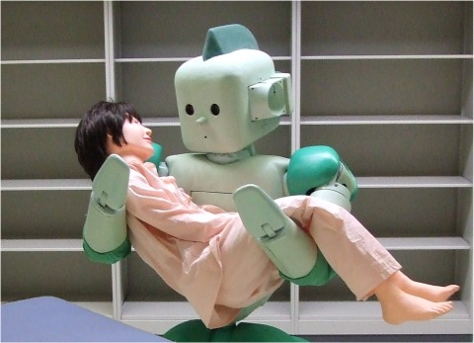
Caring the Elderly using Humanoid Robots
Feedback of force using tactile information
Sound localization
Tracking of human face by integrating auditory and visual information
Smell discernment by semiconductor gas sensor
RIKEN 2006
http://rtc.nagoya.riken.jp/RI-MAN/index_us.html

Slide 6
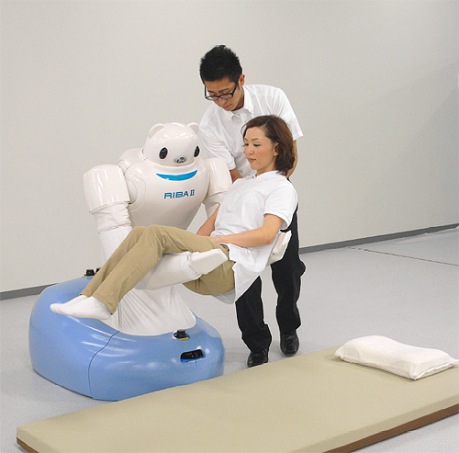
Caring the Elderly using Humanoid Robots
RIBA-II can crouch down and lift a patient off a futon at floor level.
RIBA-II can detect a person’s weight from touch alone using capacitive tactile sensors made
of rubber.
RIBA-II 2011
http://www.riken.jp/en/pr/press/2011/20110802_2/

Slide 7
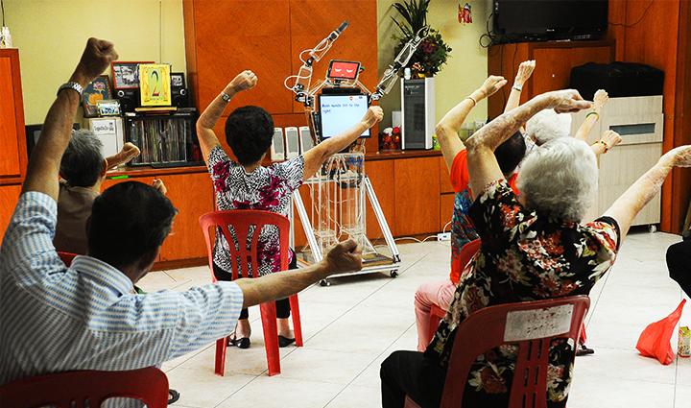
Caring the Elderly using Humanoid Robots
Robocoach coaches
the elderly to perform
15 types of arm exercise.
Ngee Ann Polytechnic’s School of Engineering, 2015

Slide 8
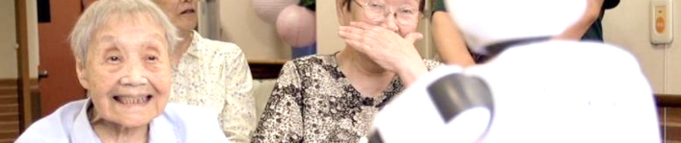
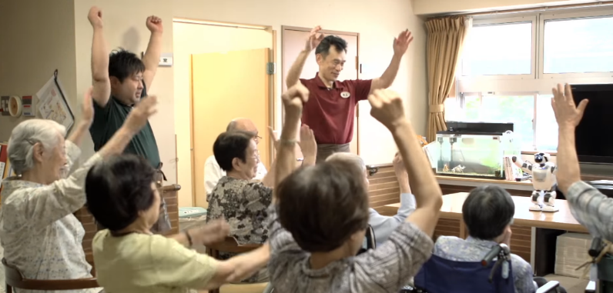
Caring the Elderly using Humanoid Robots
Analysis of sound types, recognition of faces, detection of moving bodies, identification of individuals from voice prints, recognition of sound source direction.
PALRO can be used for recreational activities for the elderly covering games, exercises, quiz and music.
Palro Robot 2016
https://palro.jp/en/feature

Slide 9
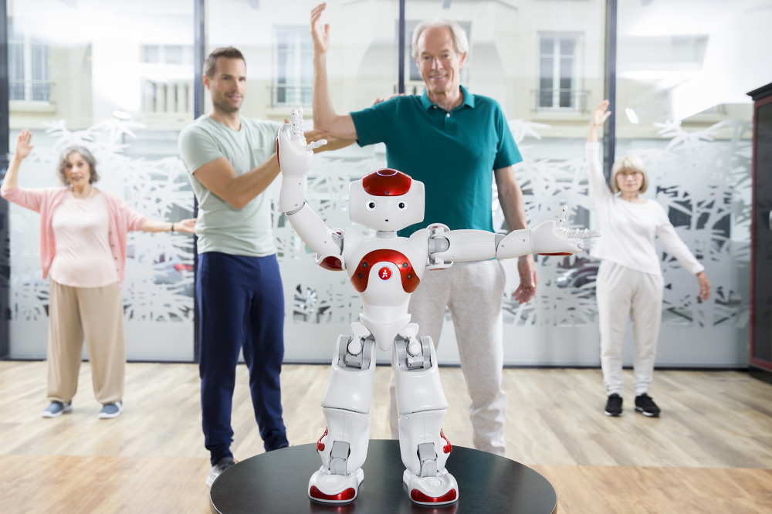
Caring the Elderly using Humanoid Robots
NAO has been used as an instructor for therapies in rehabilitation
NAO 2016
https://www.ald.softbankrobotics.com/en/cool-robots/nao/find-out-more-about-nao

Slide 10
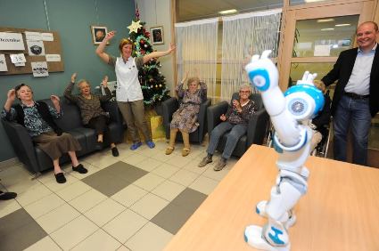
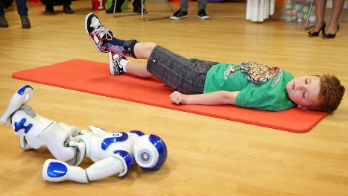
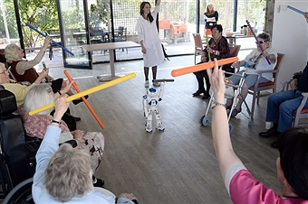
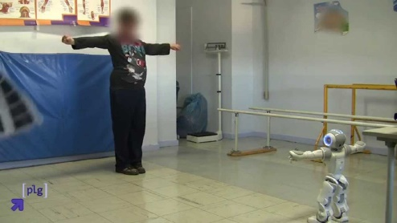
Caring the Elderly using Humanoid Robots
ZORA 2016
https://www.ald.softbankrobotics.com/en/cool-robots/nao/find-out-more-about-nao

Slide 11
PROPOSAL
The aim of ROCY is to develop methodologies for
Measurement
Monitoring, and
Understanding the physical activity of the elderly

Slide 12
ROCY’s DEMO

Slide 13
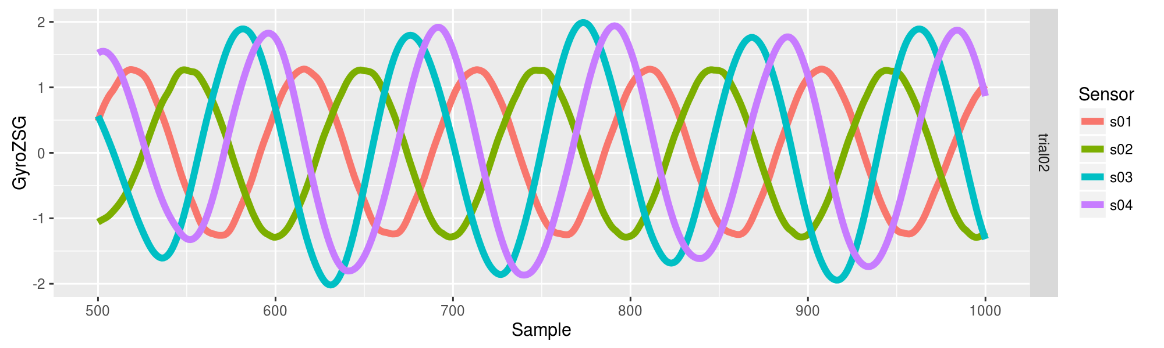
Good Human-Robot Imitation

Slide 14
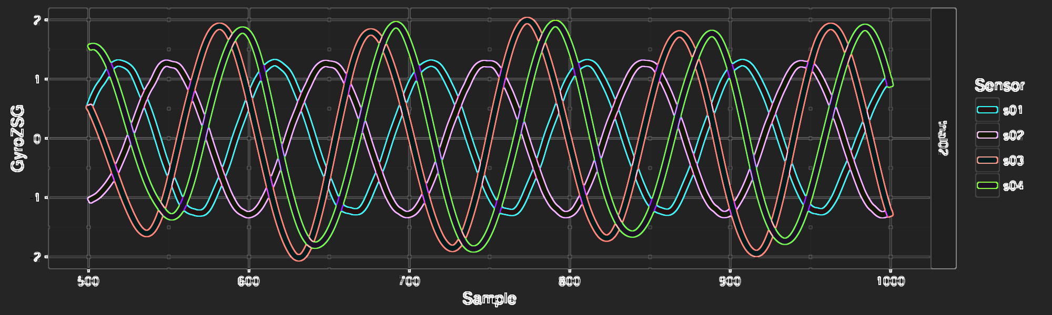
Good Human-Robot Imitation
Left Hand
Right Hand
ROBOT
HUMAN

Slide 15
Bad Human-Robot Imitation

Slide 16
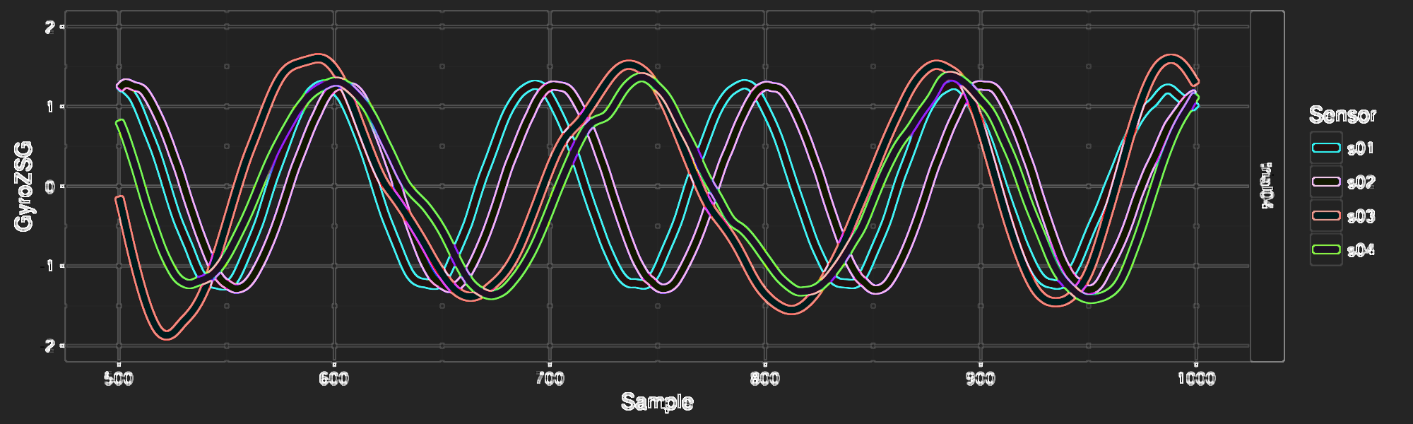
Bad Human-Robot Imitation
Left Hand
Right Hand
ROBOT
HUMAN

Slide 17
Why you should invest in ROCY?
People/ Society
Knowledge
Economy
ROCY

Slide 18
ROCY RObot Carer for the elderlY
Miguel P. Xochicale
Doctoral Researcher in Human-Robot Interaction
University of Birmingham, UK
@_mxochicale

